Slide 1
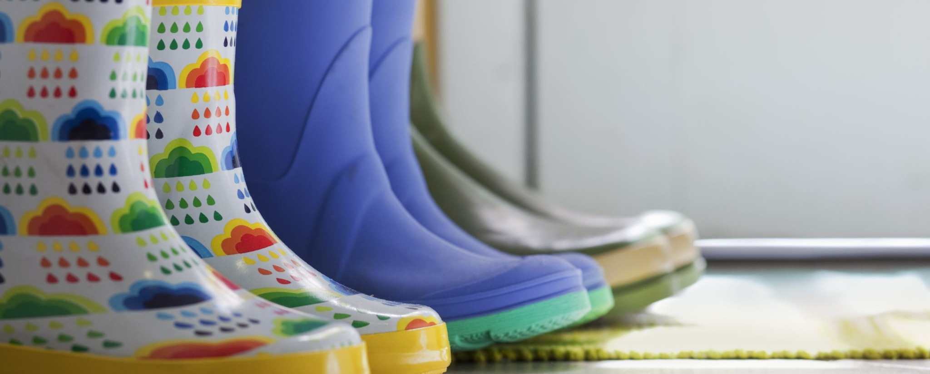
Shoe Decider
Don’t feel like making the decision of choosing your shoes on your own? the Shoe Decider is here to save the day
Carnoshia Wechsberg
CHANTAWIES NEANG-mackie

